Slide 1



Noida Institute of Engineering and Technology, Greater Noida
Aptitude 2
Unit: Ⅴ
Subject Name
Mathematics Ⅱ
Faculty Name
Mr. Sudhir Singh
Department
Mathematics
Course Details B Tech- 2nd Sem.

Slide 2
Contents
Ratio, Proportion & Partnership
Problem of ages
Allegation & Mixture
Simple interest & Compound Interest
Directions
Blood Relation

Slide 3
Course Objective
Course Objective This course aims to sensitize students with the gamut of skills which facilitate them to enhance their employability quotient and do well in the professional space. These skills are imperative for students to establish a stronger connect with the environment in which they operate.

Slide 4
Course Outcomes 2020-21 (B. Tech. – 1st Sem)
Course Name: Mathematics-I (KAS 103)
CO1 | Apply the concept of differentiation to solve differential equations.
CO2 | Apply the concept of convergence of sequence and series to evaluate Fourier series
CO3 | Apply the Laplace transform to solve ordinary differential equations
CO4 | Apply the concept of vector calculus to evaluate line, surface and volume integrals.
CO5 | Demonstrate the basic concept Proportion & Partnership, Problem of ages, Allegation & Mixture, Direction, Blood relation , Simple & Compound interest

Slide 5
CO-PO Mapping 2020-21 (B. Tech. – 1st Sem)
Course Name: Mathematics-I (KAS 103)
CO | PO-1 | PO-2 | PO-3 | PO-4 | PO-5 | PO-6 | PO-7 | PO-8 | PO-9 | PO-10 | PO-11 | PO-12
CO1 | 3 | 2 | 1 | 1 | 3 | 2 | - | - | - | 2 | 2 | 3
CO2 | 3 | 3 | 2 | 3 | 3 | - | - | - | - | 2 | 3 | 3
CO3 | 3 | 2 | 3 | 3 | 3 | 2 | - | - | - | 2 | 3 | 3
CO4 | 3 | 2 | 3 | 3 | 2 | 2 | - | - | - | 2 | 2 | 3
CO5 | 1 | 1 | 1 | 1 | 1 | - | - | - | - | 2 | - | 3
Mean | 2.6 | 2 | 2 | 2.2 | 2.4 | 2.0 | - | - | - | 2 | 2.5 | 3

Slide 6
Prerequisite
Basic concept of mathematics

Slide 7
Ratio, Proportion & Partnership
Ratio :
The number of times one quantity contains another quantity of the same kind is called the ratio of the two quantity.
The first term of the ratio is called the antecedent and the second the consequent.
In the ratio a : b , ‘a’ is the antecedent and ‘b’ is the consequent.

Slide 8
Ratio, Proportion & Partnership (Contd.)
TYPE 1: BASIC PROBLEMS
In this type Question contains Individual Ratio/Total Ratio and Individual Value/Total Value then you will be asked to find the Ratio or Value.
Example : If a certain sum of money is distributed among A and B in the ratio 4:3 and B gets ₹3000,then what is total money distributed?
Solution : A B A+B
4x 3x 7x
3x = 3000 or x = 1000
total money distributed = 7x = 7 × 1000 =₹ 7000

Slide 9
Ratio, Proportion & Partnership (Contd.)
TYPE 2: BASED ON EFFICIENCY
In this type efficiency of the Person is given and the ratio were also given we have to find the new ratio.
Example : Seats for mathematics, physics and biology in a school are in the ratio 5:7:8.There is a proposal to increase these seats by 40%,50% and 75% respectively. What will be the ratio of increased seats?
Solution : The ratio’s are 5x:7x:8x ; let x=10 then,
Mathematics=50 Physics =70 Biology=80
Then Increased Percentage be 40%,50% and 75%:
10% of 50=5 then 140% of 50=70
10% of 70=7 then 150% 0f 70=105
10%of 80=8 then 175% of 80=140
Mathematics=70 Physics =105 Biology=140
Their increased ratio=2:3:4

Slide 10
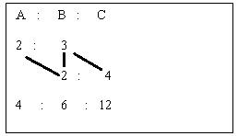
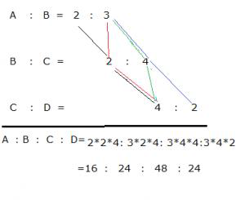
Ratio, Proportion & Partnership (Contd.)
TYPE 3: FORMATION OF NEW RATIO’S
Example 1 : If a:b=2:3 and b:c=2:4 then a:b:c=?
Solution :
Therefore the new Ratio=2:3:6
Example 2 : If a:b=2:3 and b:c= 2:4 and c:d= 4:2 then a:b:c:d=?
Solution :

Slide 11
Ratio, Proportion & Partnership (Contd.)
Proportion
If the ratio of the first and second quantities is equal to the ratio of the third and fourth quantities then it is called proportion.
It is represented by → ‘::’
i.e. if a:b=c:d, we write a:b::c:d and we say that a, b, c, d are in proportional
Here a and d are called extremes while b and c are called mean terms.
⇒ Fourth Proportional: If a:b = c:d, then d is called the fourth proportional to a, b, c.
⇒Fourth Proportional(d) = (b × c)/a

Slide 12
Ratio, Proportion & Partnership (Contd.)
⇒ Third Proportional: If a : b = b : c, then c is called the third proportional to a and b.
⇒Third Proportional(c) = b²/a
⇒Mean Proportional between a and b = √ab.
⇒Duplicate ratio of a : b = a²:b² .
⇒Sub-duplicate ratio of a:b = √a:√b .
⇒Triplicate ratio of a : b = a³ : b³

Slide 13

Ratio, Proportion & Partnership (Contd.)
Example 1 : The fourth proportional to 4, 9, 12 is.
Solution : Let the fourth proportional to 4, 9, 12 be x.
then 4:9::12:x
⇒4×x=9×12 (i.e. a × d = b × c)
∴ x=27 Ans.
Example 2 : The third proportional to 16 and 36 is.
Solution : Let the third proportional to 16 and 36 be x
then 16 : 36:: 36 : x
⇒ 16×x=36×36
∴ x=81 Ans.
Example 3 : The mean proportional between 0.08 and 0.18 is.
Solution : The mean proportional between 0.08 and 0.18=

Slide 14
Ratio, Proportion & Partnership (Contd.)
Partnership :
When two or more than two persons invest in a business it becomes a partnership. There are two kinds of partners as discussed below.
Working Partners :
He is the partner who apart from investing the money, runs the business as well. Some times working partners also take a fixed salary or some percentage of the total profit to run the business.
(2) Sleeping Partners :
A partner who only invests in the business is known as sleeping partner.

Slide 15
Ratio, Proportion & Partnership (Contd.)
Example : P, Q and R start a business with ₹ 30,000, ₹ 40,000 ₹ 50,000 respectively. P stays for the entire year. Q leaves the business after two months but rejoins after another 4months but only 3/4 of his initial capital. R leaves after 3 months and rejoins after another 5months but with only 4/5 of his capital. If the year end profit is ₹ 27,900, how much more than Q did R get?
Solution : Investment ratio
P : Q : R = 30000 × 12: (40000 × 2+30000 × 6) : (50000 × 3+40000 × 4) = 36:26:31
Total profit is ₹ 27900
Then (36+26+31) = 93 =
= 27900 Diff of Q-R (31-26) 5 = 27900 × 5/93 = ₹1500

Slide 16
Multiple Choice Questions
Ques.1 : If a:b=4:5, b:c= 3:4, c:d = 7:11,then a:d is
(a) 3:4 (b) 21:55 (c) 21:44 (d) 7:5
Ques.2 : If a = 2b = 3c = 4d, then a : b : c : d is
12:3:6:4 (b) 3:4:6:12 (c) 6:12:4:3 (d) 12:6:4:3
Ques. 3 : ₹ 3960 are divided among A,B and C so that half of A’s part, one-third of B’s part and one-sixth of C’s part are equal. Then C’s part is
(a) 720 (b) 2160 (c) 1080 (d) 810
Ques. 4 :A, B, C started a business with their investments in the ratio 3:6:5. After 8 months, A invested the same amount as before and both B and C withdrew half of their investments. The ratio of their profits at the end of the year is:
(a) 22:30:24 (b) 18:30:25 (c) 16:18:22 (d) 20:15:18

Slide 17
Multiple Choice Questions
Ques. 5 : find the mean proportional between 17 and 68.
51 (b) 24 (c) 4 (d) 34
Ques. 6 : The fourth proportional to 4, 7 and 20 is :
(a) 28 (b) 21 (c)18 (d) 35
Ques. 7 : Third proportional between 16 and 36 is:
64 (b) 144 (c) 81 (d) 49
Ques. 8 : Ramesh had 50 paise coins,₹ 1 coins and ₹ 5 coins in the ratio of 2:3:5. the total amount of money with Ramesh is ₹ 116.What is the number of 50 paise coins with him?
6 (b) 4 (c) 12 (d) 8
Ques. 9 : A and B starts a business with investment of ₹ 28000 and ₹ 42000 respectively. A invests for 8 months and B invests for 1 year. If the total profit at the end of year is₹ 21125,then what is the share of B?
(a)₹ 14625 (b)₹ 12625
(c) ₹13575 (d) ₹14285

Slide 18
Assignment - 1
Ques. 1 : A, B and C enter into a partnership with a capital in which A’s contribution is Rs. 15,000. If out of a total profit of Rs. 1000, A gets Rs. 500 and B gets Rs. 300, then C’s capital is :
(a) 4000 (b) 5000 (c) 6000 (d) 7000
Ques. 2 : If P : Q = 2 : 3 , Q : R = 4 : 5 and R : S = 6 : 7 , then P : S = ?
(a) 18: 25 (b) 17: 35 (c) 16: 35 (d) 8: 11
Ques. 3 : A boy has coins in the denominations of ₹ 1 and ₹ 2. If he has total 30 coins and the value of coins is ₹ 48. Find the number of ₹ 1 coins he has.
(a) 18 (b) 10 (c) 12 (d) 14
Ques. 4 : Share ₹ 4200 among Jay, Sanjay and Vijay in the ration 2: 4: 6.Find the amount received by Sanjay.
(a) ₹ 1200 (b) ₹ 1300 (c) ₹ 1400 (d) ₹ 1500

Slide 19
Assignment - 1
Ques. 5 : Divide ₹ 600 among A, B and C so that ₹ 40 more than 2/5th of A's share, ₹ 20 more than 2/7 of B's share and ₹ 10 more than 9/17th of C's share are all equal. What is A's share?
(a) ₹ 280 (b) ₹ 150 (c) ₹ 170 (d) ₹ 200
Ques. 6 : In a class, the number of boys is more than the number of girls by 12%. The ratio of boys to girls is:
11:4 (b) 14:11 (c) 25:28 (d) 28:25
Ques. 7 : A sum of ₹ 350 made up of 110 coins, which are of either ₹ 1 or ₹ 5 denominations. How many coins are of ₹ 5?
(a) 52 (b) 60 (c) 62 (d) 72

Slide 20
Assignment - 1
Ques. 8 : If 378 coins consist of rupees, 50 paise and 25 paise coins, whose values are in the ratio of 13:11:7, the number of 50 paise coins will be
(a) 132 (b) 128 (c) 136 (d) 133
Ques. 9 : Amit started a business by investing ₹ 30,000. Rahul joined the business after some time and invested ₹ 20,000. At the end of the year, profit was divided in the ratio of 2: 1. After how many months did Rahul join the business?
(a) 9 (b) 3 (c) 4 (d) 5
Ques. 10 : The monthly income of Komal and Asha are in the ratio of 4: 3. Their monthly expenses are in the ratio of 3: 2. However both saves ₹ 600 per month. What is their total monthly income?
(a) ₹ 8400 (b) ₹ 5600 (c)₹ 4200 (d)₹ 2800

Slide 21
Recap
Basic concept of ratio
Type of ratio
BASIC PROBLEMS
Based on Efficiency
Formation of new ratio’s
Basic concept of Proportion
Third Proportional(c) = b²/a
Mean Proportional between a and b = √ab.
Basic concept of Partnership
Working Partner (2) Sleeping Partner

Slide 22
Problem of Ages
Important Statements and Equations for "Problems based on Ages":
If the present age is y, then n times the present age = ny
If the present age is x, then age n years later/hence = x + n
If the present age is x, then age n years ago = x – n
The ages in a ratio a: b will be ax and bx.
If the current age is y, then 1/n of the age is y/n.

Slide 23
Problem of Ages ( Contd. )
Example 1 : Ratio of ages of Reena and Prerna is 2 : 3 and the ratio of ages of Tiya and Reena is 3 : 1. If the ratio of age of Prerna four years hence to age of Tiya three years hence is 5 : 9, what is the total of the ages of all three?
Solution : P/R = 3/2 and R/T = 1/3
So P : R : T =
3×1 : 2×1 : 2×3 = 3 : 2 : 6
Now (3x+4)/(6x+3) = 5/9
So x = 7
P = 3x = 21, R = 2x = 14, T = 6x = 42
So P + R + T = 77

Slide 24
Problem of Ages ( Contd. )
Example 2 : Richa‘s age is thrice of Tisha‘s age while Megha‘s age is 3 less than that of Richa‘s. The ratio of ages of Tisha‘s three years hence to Megha‘s four years ago is 3 : 5. What is the square root of the total age of Tisha and Richa?
Solution : Tisha = x, Richa = 3x, Megha = 3x – 3
(x+3)/(3x-3-4) = 3/5
Solve, x = 9
So total age of Tisha + Richa = x + 3x = 4x = 36, So square root = √36 = 6

Slide 25
Multiple Choice Question
Ques. 1 : Kashish‘s age is two-fifth the age of her mother. Nine years hence her age will be half of her mother‘s age that time. What is her mother‘s present age?
(a) 22 (b) 45 (c) 54 (d) 36
Ques. 2 : Sneha‘s mother‘s age is five years more than twice the age of Sneha. When Sneha was born, her brother Rahul was four years old and her father two years older than her mother. If the average age of her mother and father is 46 years. Find the ratio of age of Rahul to that of Sneha.
(a) 3 : 7 (b) 7 : 4 (c) 6 : 5 (d) 8 : 11

Slide 26
Multiple Choice Questions
Ques. 3 : Vishal is 16 years younger than Sumit. 12 years hence, Sumit’s age will be 1.5 times that of Vishal. Sumit is now…………..years old.
(a) 42 (b) 45 (c) 40 (d) 36
Ques. 4 : Parul is 9 years younger than Vani. 13 years hence Vani will be 1.2 times as old as Parul. Find Parul’s present age.
(a) 28 yr (b) 32 yr (c) 30 yr (d) 33 yr
Ques. 5 : Four years ago Shyam‟s age was 3/4 times that of Ram. Four years hence, Shyam‟s age will be 5/6 times that of Ram. What is the present age of Shyam ?
(a) 15 years (b) 20 years (c) 16 years (d) 24 years

Slide 27

ALIIGATION & MIXTURE
Mixture : When two or more than two substance are mixed in any ratio, then the resultant product is known as mixture.
Mean Price : The cost price of a unit quantity of the mixture is called the mean price.
Allegation Rule : Let cost price of a unity of cheaper article is ₹ C and that of a unit of dearer article is ₹ D. If the average price of mixture is ₹ M, then
A container initially contains x units of a liquid if ‘ a’ units of liquid are taken out and replaced by ‘ a’ unit of water repeatedly up-to ‘n’ times, then the final quantity of the original liquid left in the container is
given as [x (1− a/x)^{n}] units

Slide 28
ALIIGATION & MIXTURE
ALIIGATION & MIXTURE (Contd.)
Example 1 :The milk and water in a mixture are in the ratio 7:5. When 15 L of water are added to it, the ratio of milk and water in the new mixture becomes 7:8. The total quantity of water in the new mixture is.
Solution : Let the initial quantity of milk in mixture=7x and water=5x
adding 15 liters of water then
7x/(5x+15) = 7/8
56x = 35x+105
∴ x = 5
In new mixture milk=7x and water=8x
The quantity of water in the new mixture=8x=8×5=40 liters

Slide 29

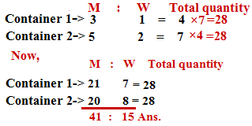
ALIIGATION & MIXTURE (Contd.)
Example 2 : There are two containers of equal capacity. The ratio of milk to water in the first container is 3:1, in the second container 5:2. If they are mixed up, the ratio of milk to water in the mixture will be.
Solution :
Now,

Slide 30
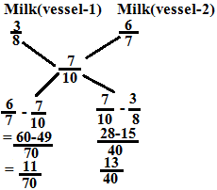
Assignment - 1
ALIIGATION & MIXTURE (Contd.)
Example 3 :Two vessels contain milk and water in the ratio 3:5 and 6:1. Find the ratio in which the contents of the two vessels have to be mixed to get a new mixture in which the ratio of milk and water is 7:3.
Solution :
∴ Required ratio=(11/70):(13/40)
=44:91 Ans.

Slide 31

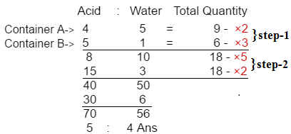
Assignment - 1
ALIIGATION & MIXTURE (Contd.)
Example 4 : Two container A and B contain a mixture of Acid and water in the ratio of 4:5 and 5:1. If both containers are mixed in the proportion of 5:2 respectively, Find the ratio of acid and water in the newly formed mixture is.
Solution :

Slide 32
Multiple Choice Questions
Ques. 1: A shopkeeper bought 30 kg of rice at the rate of Rs. 70 per kg and 20 kg of rice at the rate of Rs. 70.75 per kg. If he mixed the two brands of rice and sold the mixture at Rs. 80.50 per kg, his gain is
(a) Rs. 450 (b) Rs. 510 (c) Rs. 525 (d) Rs. 485
Ques. 2: Two alloys contain tin and iron in ratio of 1:2 and 2:3. If the two alloys are mixed in the proportion of 3:4 respectively (by weight), the ratio of tin and iron in the newly formed alloy is
(a) 10:21 (b) 13:22 (c) 14:25 (d) 12:23
Ques. 3: Three utensils contain equal quantity of mixtures of milk and water in the ratio 6:1, 5:2 and 3:1 respectively. If all the solutions are mixed together, the ratio of milk and water in the final mixture is
(a) 65:28 (b) 65:19 (c) 19:65 (d) 19:28

Slide 33
Profit & Loss
Multiple Choice Questions
Ques. 4 : In 60 liters beverage, the ratio of syrup and water is 3:7. If the ratio of the syrup and water is to be made 2:5, then the amount of water to be further added is
(a) 5 liters (b) 2.5 liters (c) 2 liters (d) 3 liters
Ques. 5 : A container has 80 L of milk, from this container 8 L of milk was taken out and replaced by water. The process was further repeated twice. The value of milk in the container after that is:
(a) 85.32 L (b) 58.23 L (c) 85.23 L (d) 58.32 L
Ques. 6 : 40 L of a mixture of milk and water contains 10 % water. How much water must be added to make the water 20 % in the new mixture?
(a) 5 (b) 4 (c) 10 (d) 6

Slide 34
Assignment - 2
Ques. 1 : 60 kg of an alloy A is mixed with 100 kg of alloy B. If alloy A has lead and tin in the ratio 3:2 and alloy B has tin and copper in ratio 1:4, the amount of tin in the new alloy is
(a) 80 kg (b) 44 kg (c) 53 kg (d) 24 kg
Ques. 2 : The milk and water in two vessel A and B are in the ratio 4:3 and 2:3 respectively. In what ratio, the liquids in both the vessels be mixed to obtain a new mixture in vessel C containing half milk and half water?
(a) 7:5 (b) 5:2 (c) 3:11 (d) 1:2
Ques. 3 : 20 liters of a mixture contains 20% alcohol and the rest water. If 4 liters of water be mixed in it, the percentage of alcohol in the new mixture will be
(a) 33.33% (b) 16.67% (c) 25% (d) 12.5%

Slide 35
Profit & Loss(Contd.)
Assignment – 2 (Contd.)
Ques. 4 : A vessel is filled with liquid, which is 3 parts water and 5 parts milk. How much of the liquid should be drawn of and replaced by water to make it half water and half milk?
(a) 1/8 (b) 1/5 (c) 2/3 (d) 2/7
Ques. 5 : A container contains 50 L of milk. From this container 5 L of milk was taken out and replaced by water. This process was repeated further two times. How much milk is now contained by the container?
28.50 (b) 36.45 (c) 25.5 (d) 32.25
Ques.6 : A container contained 60ltr milk. Out of this 6ltr of milk was taken out and replaced with water. This process was further repeated two times. How much milk is now in container?
(a) 42.74 (b) 43.74 (c) 44.74 (d) 45.74

Slide 36
Profit & Loss (Contd.)
Assignment – 2 (Contd.)
Ques. 7 : ₹ 69 were divided among 115 students so that each girl gets 50 paise less than a boy. Thus each boy received twice the paise as each girl received. The no. of girls in the class is:
47 (b) 23 (c) 92 (d) 25
Ques. 8 : P and Q are two alloys of gold and copper prepared by mixing metals in the ratio 7 : 2 and 7 : 11 resp. If equal quantities of the alloys are melted to form a third alloy R, Find the ratio of gold and copper.
(a) 6 : 7 (b) 7 : 5 (c) 4 : 3 (d) 5 : 6
Ques. 9 : Two vessel contain milk and water in ratio 3:2 and 7:3. Find the ratio in which the contents of the two vessels have to be mixed to get a new mixture in which the ratio of milk and water is 2:1.
(a) 4:1 (b) 1:4 (c) 2:1 (d) 1:2

Slide 37
Recap
A container initially contains x units of a liquid if ‘ a’ units of liquid are taken out and replaced by ‘ a’ unit of water repeatedly up-to ‘n’ times, then the final quantity of the original liquid left in the container is
given as [x (1− a/x)^{n}] units

Slide 38

Simple Interest & Compound interest
Basic Concept of Simple Interest (SI)
Principal (P): The original sum of money loaned/deposited. Also known as capital.
Interest (I): The amount of money that you pay to borrow money or the amount of money that you earn on a deposit.
Time (T): The duration for which the money is borrowed/deposited.
Rate of Interest (R): The percent of interest that you pay for money borrowed, or earn for money deposited
The Formula :
Where:
P: Principal (original amount) R: Rate of Interest (in %)
T: Time period (yearly, half-yearly etc.)
Amount Due at the end of the time period, A = P (original amount) + SI

Slide 39

Discount(Contd.)
Simple Interest & Compound interest
Example 1 : What is the SI on ₹ 7500 at the rate of 12% per annum for 8 years?
Solution : Given P = ₹ 7500, T = 8 Years, R = 12%
Simple Interest (S.I.) = ₹ 7200
Example 2 : A man borrowed ₹ 15000 at the rate of 24% SI and to clear the debt after 6years, much he has to return:
Solution : Given P = 15000, T = 6 Years, R = 24%
Simple Interest = (15000×24×6)/100= ₹ 21600
Therefore, total interest = 21600
Total repayment = S.I + Principal amount = 21600 + 15000 = ₹ 36600

Slide 40




Discount (Contd.)
Simple Interest & Compound interest
Example 3: The simple interest on a certain sum of money at 4% per annum for 4 yrs is ₹ 80 more than the interest on the same sum for 3 yrs at 5% per annum. Find the sum.
Solution : Let the sum be ₹ x , then at 4% rate for 4 yrs the simple interest
=
At 5% rate for 3 yrs the simple interest =
or
Or x = ₹ 8000

Slide 41

Simple Interest & Compound Interest
Note : A sum of money becomes x times in T years. In how many years will it become y times?
For SI : Formula =
Example : A sum of money becomes three times in 5 years. In how many years will the same sum become 6 times at the same rate of simple interest?
Solution : [(6 – 1)/(3 – 1)] × 5 = 5/2 × 5 = 12.5 years

Slide 42



Multiple Choice Questions
SI & CI (Contd.)
^{n}
^{n}
Important formulas for Compound Interest :
When interest is compounded annually : n
(2) When interest is compounded half-yearly :
2n
(3) When interest is compounded Quarterly :
4n
Where
P = Principal ; R = rate of interest per annum
n = time (yearly, monthly etc.) ; A = Amount (sum of money)

Slide 43



SI & CI (Contd.)
Note : A sum of money becomes x times in T years. In how many years will it become y times?
For CI : Formula = (logy/logx) × T
Difference between CI and SI
Note the following things-
If t=1 year, then SI = CI
If t=2 years then difference between CI and SI can be given by two formulas- (1) 2 (2)
If t=3 years then difference between CI and SI can be given by formulas- 2

Slide 44
SI & CI (Contd.)
Example 1 : If the difference between CI and SI earned on a certain amount at 20% pa at the end of 3 years is ₹ 640, find out the principal.
Solution : SI-CI for 3 yrs =P(R/100 +3) × (R/100)²
640 = P (3 + 20/100) × (20/100)²
P=₹ 5000
Example 2 : If a sum of ₹ 8000 landed for 20% per annum at compound interest then the sum of the amount will be ₹ 13824. Find the time.
Solution: A = ₹ 13824 P = ₹ 8000, R = 20% per annum
A = P (1 + R/100)^{n}
13824 = 8000 (1 + 20/100)^{n}
(12/10)^{n} = (12/10)³
n = 3 yrs.

Slide 45
SI & CI (Contd.)
Example 3 : Arjun lent out a sum of money at compound interest rate of 30% per annum for 2 years .It would fetch ₹500 more if interest is compounded half –yearly.
Solution : P[(1+15/100)⁴ – (1 +30/100)²] = 500
P =₹ 8333.33
Example 4 : If a principal becomes triple in 4yrs at C.I then find in how many years it will be nine fold?
Solution : 3P = P (1 + R/100)⁴
(1+R/100) = (3)^{1/4}
9P = P (1+ R/100)^{n}
3² = 3^{n/4}
n = 8

Slide 46
Multiple Choice Questions
Ques. 1 : S.I on a sum for 3yrs at any rate of interest is ₹ 450 while C.I on the same sum at the same rate for 2 yrs is ₹ 315. Find the sum and rate percent?
(a) 5% ,₹1500 (b) 10%, ₹1500 (c) 5%,₹2000 (d) 10%,₹2000
Ques. 2 : Find the compound interest on ₹ 36,000 at a rate in which ₹ 216 becomes ₹ 343 in 3years and the time is 2years?
₹12000 (b) ₹12500 (c) ₹13000 (d) ₹13500
Ques. 3 : If a principal becomes triple in 3years on C.I. then find in how many years it will be 27 fold?
(a) 39 years (b) 9 years (c) 18 years (d) 27 years

Slide 47
Multiple Choice Questions
Ques. 4 : Find the compound interest on ₹18000 at 20% rate of interest in 1.5 years, if compounded half yearly ?
₹5958 (b) ₹4916 (c) ₹5780 (d) ₹3500
Ques. 5 : If the principal become 6 fold on S.I in 10 years then find in how many years it will be 12 fold?
24years (b) 22years (c) 12years (d) 20years
Ques. 6 : If the compound interest on a sum at 25% rate of interest is ₹ 900 then find the S.I of 3years at same rate?
(a) ₹1000 (b) ₹1100 (c) ₹1300 (d) ₹1200

Slide 48
Assignment- 3
Ques. 1 : The simple interest on a certain sum of money at 4% per annum for 4 years is ₹80 more than the simple interest on the same sum of money for 3 years at 5% per annum. Find the sum
(a) ₹ 4000 (b) ₹ 8000 (c) ₹ 4030 (d) none of these
Ques. 2 : In what time will ₹ 2000 amount to ₹ 2500 at 10% per annum simple interest?
(a) 2.5 years (b) 1.5 years (c) 2 years (d) 5 years
Ques. 3 : A sum of money at simple interest amount to ₹ 1045 in 5 years and to ₹ 1111 in 6years.The sum is
(a) Rs 945 (b) Rs 715 (c) Rs 845 (d) Rs775

Slide 49
Assignment- 3(Contd.)
Ques. 4 : The simple interest on a sum of money will be ₹600 after 10 years. If the principal is tripled after 5 years, what will be the total interest at the end of the tenth year?
₹ 600 (b) ₹ 900 (c) ₹1200 (d) Data inadequate
Ques. 5 : A sum of money becomes ₹ 6690 after three years and ₹ 10,035 after 6 years on compound interest. The sum is:
₹ 4400 (b) ₹ 4445 (c) ₹ 4460 (d) ₹ 4520
Ques. 6 : The difference between simple interest and compound interest on a sum for 2 years at 8%, when the interest is compounded annually ₹ 16. If the interest was compounded half-yearly, the difference in two interests would be nearly :
(a) ₹ 16 (b) ₹16.80 (c) ₹ 21.85 (d) ₹ 24.64

Slide 50
Assignment- 3 (Contd.)
Ques. 7 : The least number of complete years in which a sum of money put out at 20% C.I. will be more than doubled is:
(a) 3 (b) 4 (c) 5 (d) 6
Ques. 8 : A sum amounts to ₹ 2916 in 2 years and to ₹ 3149.28 in 3 years at compound interest. The sum is:
(a) ₹ 1500 (b) ₹ 2000 (c) ₹ 2500 (d) ₹ 3000
Ques. 9 : The difference between simple interest and compound interest at the same rate for ₹ 5000 for 2 years is ₹ 72. The rate of interest is:
10% (b) 12% (c) 6% (d) 8%
Ques. 10 : A sum of money placed at C.I doubles itself in 5 years. It will amount to eight times itself in:
(a) 15 years (b) 20 years (c) 12 years (d) 10 years

Slide 51
Recap
Formula
Important formulas for Compound Interest :
When interest is compounded annually :
n
Note : A sum of money becomes x times in T years. In how many years will it become y times?
For SI : Formula =
For CI : Formula = (logy/logx) × T

Slide 52
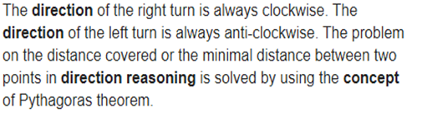
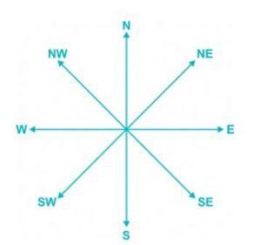
DIRECTION
Basic concept of direction :
Four main directions : North, South, East, West
Four Cardinal Direction : North – East, North – West, South- East, South - West

Slide 53
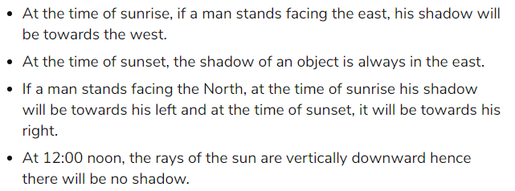
DIRECTION (Contd.)
Note :- If not mentioned we always assume that the person is facing north.

Slide 54
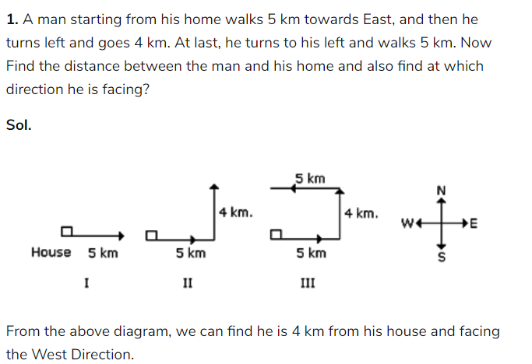
DIRECTION (Contd.)
Example :

Slide 55
DIRECTION (Contd.)
Example 2 : Sandhya starting from her house, goes 4 km in the East, then she turns to her right and goes 3 km. What is the shortest distance to reach her house?
Solution:

Slide 56
Multiple Choice Question
Ques. 1 : A man is facing south. He turns 135° in the anticlockwise direction and then 180° in the clockwise direction. Which direction is he facing now?
(a) North-east (b) North-west (c) South-east (d) South-west
Ques. 2 : A person starts towards South direction. Which of the following order of direction will lead him to East direction?
(a) Right, Right, Right (b) Left, Left, Left
(c) Left, Right, Right (d) Right, Left, Right
Ques. 3 : Kashish goes 30m North, then turns right and walks 40 m, then again turns right and walks 20 m, then again turns right and walks 40 m. How far is he from his original position?
(a) 0 (b) 10 (c) 20 (d) 40

Slide 57
Multiple Choice Question
Ques. 4 : Starting from a point P, Sachin walked 20 m towards South. He turned left and walked 30 m. He then turned left and walked 20 m. He again turned left and walked 40 m and reached a point Q. How far and in which direction is the point Q from the point P?
20 m, West (b) 10 m, East (c) 10 m, West (d) 10 m, North
Ques. 5 : Sanjeev walks 10 m towards the South. Turning to the left, he walks 20 m and then moves to his right. After moving a distance of 20 m, he turns to the right and walks 20 m. Finally, he turns to the right and moves a distance of 10 m. How far and in which direction is he from the starting point?
(a) 10 m, North (b) 20 m, South (c) 20 m, North (d) 10 m, South

Slide 58
Assignment - 4
Ques. 1 : Travelled from a point X straight to Y at a distance of 80 m. He turned right and walked 50 m, then again turned right and walked 70 m. Finally, he turned right and walked 50 m. How far is he from the starting point?
(a)10 m (b) 20 m (c) 50 m (d)70 m
Ques. 2 : In an open ground, Rakesh walks 20 m towards North, turns left and goes 40 m. He turns to his left again to walk 50 m. How far is he from starting point?
(a) 40m (b) 50m (c) 70m (d) 80m
Ques. 3 : Vinod starts from his house and travels 4 km in East direction after that he turns towards left and moves 4 km. Finally, he turns towards left and moves 4 km. At what distance and in which direction he finally stands from his starting point?
(a) North, 4 km (b) North-East, 4 km (c) South, 12 km (d) West, 4 km

Slide 59
Assignment - 4
Ques. 4 : A person moves 15 km in East direction then turns towards North and moves 4 km. From here he turns towards West and travels 12 km. How far and in which direction is he from his starting point?
31 km, South-East (b) 5 km, North-East
(c) 19 km, North-East (d) 27 km, South-West
Ques. 5 : Shreya started from point P and 2 m towards West. She then took a right turn and walked 3 m before taking left turn and walking 5 m. She finally took a left turn, walked 3 m and stopped at a point Q. How far is point Q from point P?
(a) 2 m (b) 6 m (c) 7 m (d) 8 m

Slide 60
Assignment - 4
Ques. 6 : I was facing East from where I turned to my left and walked 12 feet then I turned towards right and walked 6 feet. After that I walked 6 feet in South direction and at last walked 6 feet in the West. Then, in which direction am I standing from the original point?
West (b) East (c) North (d) South
Ques. 7 : Radha left her home in the morning and walked towards the East for 4 km and then took a 900 anticlockwise turn and walked for another 3 km to reach her school. On the same day in the morning, her brother Raman left the same house and walked towards the South for 6 km and took a right turn and walked for 8 km to reach his college. What is the shortest distance between Radha’s school and Raman’s college?
(a) 6 km (b) 10 km (c) 15 km (d) 29 km
.

Slide 61
Recap
Basic Directions:
Important Points To Keep In Mind In Left Right Movement:
A person facing north, on taking left will face towards west and on taking the right turn towards east.
A person facing west, on taking left will face towards south and on taking right turn towards north.
A person facing east, on taking left will face towards north and on taking the right turn towards south.
A person facing south, on taking left will face towards east and on taking the right turn towards west.

Slide 62
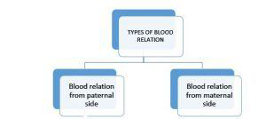

BLOOD RELATION
Basic Concept :
Important Information about Blood Relation:-
1. are used for males.
2. are used for females.
3. Without the information of gender, no relationship can be established between two people.
4. Gender can not be decided on the basis of name.
5. While solving blood relation based question, first of all find out that two persons between whom a relationship has to be established.

Slide 63
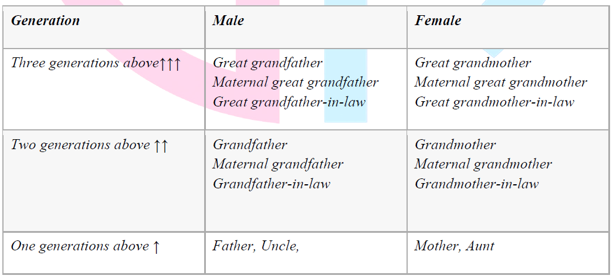
BLOOD RELATION(Contd.)
Table of Blood Relations

Slide 64
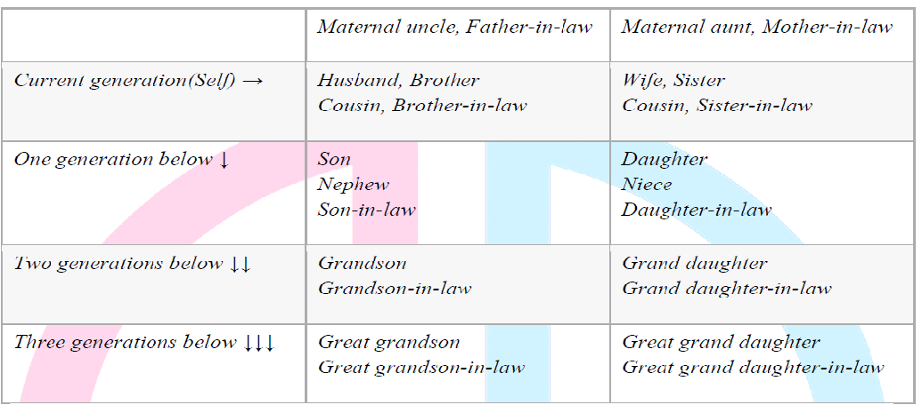
BLOOD RELATION(Contd.)

Slide 65
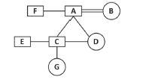
BLOOD RELATION(Contd.)
Representation of different relations:
From given generation tree we can deduce some important relationship between family members:-
A is Father of C, E and D
2. B is Mother of C, E and D
3. F is Brother of A
4. F is Brother in law of B

Slide 66
BLOOD RELATION (Contd.)
5. A is Husband of B
6. B is Wife of A
7. F is Uncle of E, C and D
8. C and E are Son of A and
9. D is Daughter of A and B
10. D is Sister of E and C
11. E is Brother of C and D
12. C is Brother of E and D
13. A is Grandfather of G
14. B is Grandmother of G
15. G is Granddaughter of A and B.

Slide 67
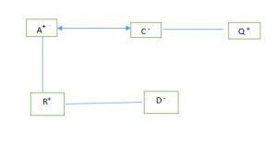
BLOOD RELATION(Contd.)
Types of Blood Relation :
(1) General Problems on Blood Relation.
(2) Blood Relation based on Family Tree.
(3) Coded Blood Relation.
Example 1 : Q is the brother of C and C is the sister of Q. R and D are brother and sister. R is the son of A while A & C are wife and husband. How is Q related with D.
Solution : For such type of question a family tree is made in which some symbols are used as below:
+ Male
- Female
| Next Generation
* Husband& Wife
= Brother and Sister

Slide 68



BLOOD RELATION(Contd.)
Step 1 - As per the question Q is the brother of C and C is the sister of Q. Hence, relation between C & Q has been presented as
where ‘–’ sign above C makes it clear that C is a female and ‘+’ sign above ‘Q’ makes it clear that Q is a male.
Step 2 - For R and D. The presentation
has been made.
Step 3 - A and C are having a husband and wife relationship and hence this has been presented as

Slide 69

BLOOD RELATION(Contd.)
Step 4 - As it is already given that C is the sister of Q and A and C are wife and husband, this becomes clear that A is the male member of the family and this is the reason A has ‘+’ as its gender sign. Lastly, the vertical line gives father and son relationship and has been presented as
Now from this family tree it becomes clear that C is the mother of R and D and as Q is the brother of C, then Q will definitely be the maternal uncle of R & D. Hence, we can say that Q is the maternal uncle of D and this is the required answer for our question

Slide 70
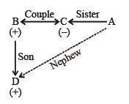
BLOOD RELATION(Contd.)
Example 2 : If P + Q means P is husband of Q,P/Q means P is the sister of Q, P*Q means P is the son of Q. How is D related to A in D*B + C/A?
Solution : C/A – >C is sister of A. B + C/A –> B is brother-in-law of A(Sister's husband – brother-in-law) D*B + C/A – >D is nephew of (Sister's husband's son means sister's son i.e., nephew) So, D is nephew to A. So, it is clearly shown that D is nephew to A.

Slide 71
Multiple Choice Questions
Ques. 1 :Pointing to a photograph, a man said, I have no brother or sister but that man's father is my father's son." Whose photograph was it ?
His own (b) His son's
(c) His father's (d) His nephew s
Ques. 2 : Anil introduces Rohit as the son of the only brother of his father's wife. How is Rohit related to Anil ?
Cousin (b) Son (c) Uncle (d) Son-in-law
Ques. 3 : Pointing out to a photograph, a man tells his friend, "She is the daughter of the only son of my father's wife." How is the girl in the photograph related to the man ?
(a) Daughter (b) Cousin (c) Mother (d) Sister

Slide 72
Multiple Choice Questions
Ques. 4 : A and B are brothers. C and D are sisters. A's son is D's brother. How is B related to C ?
(a) Father (b) Brother (c) Grandfather (d) Uncle
Ques. 5 : A and B are married couple. X and Y are brothers. X is the brother of A. How is Y related to B ?
Brother-in-Law (b) Brother
(c) Son-in-Law (d) Cousin
Ques. 6 : If A + B means A is the sister of B; A - B means A is the brother of B; A × B means A is the daughter of B, which of the following shows the relation that E is the maternal uncle of D ?
D + F× E (b) D - F× E
(c ) D × F + E (d) D×F-E

Slide 73
Multiple Choice Questions
Read the following information carefully and answer the questions that follow :
A = B means A is the son of B: A - B means A is the wife of B; A × B means A is the brother of B; A + B means A is the mother of B and A = B means A in the sister of B.
Ques. 7 : What does P + R - Q mean ?
(a) Q is the father of P. (b) Q is the son of P.
(c) Q is the uncle of P. (d) Q is the brother of P.
Ques. 8 : What does P x R + Q mean ?
(a) P is the brother of R. (b) P is the father of Q
(c) P is the uncle of Q. (d) P is the nephew of Q.
Ques. 9 : What does P= R + Q mean ?
(a) P is the aunt of Q. (b) P is the daughter of Q.
(c) P is the niece of Q. (d) P is the sister of Q.
Ques. 10 : What does P = R + Q mean ?
(a) P is the aunt of Q. (b) P is the sister of Q.
(c) Q is the niece of P. (d) Q is the daughter of P.

Slide 74
Assignment - 5
Ques.1: Pointing to a photograph of a boy Suresh said, “He is the son of the only son of my mother.” How is Suresh related to that boy?
(a) Brother (b) Uncle (c) Father (d) Cousin
Ques. 2 : If A + B means A is the mother of B; A – B means A is the brother B; A % B means A is the father of B and A x B means A is the sister of B, which of the following shows that P is the maternal uncle of Q?
(a) Q – N + M x P (b) P + S x N – Q
(c) P – M + N x Q (d) Q – S % P
Ques. 3 : Introducing a boy, a girl said, “He is the son of the daughter of the father of my uncle.” How is the boy related to the girl?
(a) Brother (b) Nephew (c) Uncle (d) Son-in-law

Slide 75
Assignment - 5
Ques.4 : Pointing towards a person, Alok said, “the person is my grandfather’s only daughter’s daughter’s uncle”. How is the person related to Alok?
Father (b) Uncle (c) Brother (d) Either (a) & (b)
Ques. 5: If A + B means A is the father of B; A – B means A is the brother B; A % B means A is the wife of B and A x B means A is the mother of B, which of the following shows that M is the maternal grandmother of T?
M x N % S + T (b) M x N – S % T
(c) M x S – N % T (d) M x N x S % T

Slide 76
Assignment - 5
Ques.6 : If P $ Q means P is the father of Q; P # Q means P is the mother of Q and P * Q means P is the sister of Q, then N # L $ P * Q shows which of the relation of Q to N?
Grandson (b) Grand-daughter
(c) Nephew (d) Data is inadequate
Ques. 7 : If A $ B means A is the brother of B; A @ B means A is the wife of B; A # B means A is the daughter of B and A * B means A is the father of B, which of the following indicates that U is the father-in-law of P?
(a) P @ Q $ T # U * W (b) P @ W $ Q * T # U
(c) P @ Q $ W * T # U (d) P @ Q $ T # W * U

Slide 77
Assignment - 5
Directions (Q. no. 8-10)
Read the following information carefully and answer the questions which follow.
‘P*Q’ means ‘P is father of Q’. ‘P#Q’ means ‘P is sister of Q’.
‘P+Q’ means ‘P is brother of Q’. ‘P-Q’ means ‘P is mother of Q’.
‘P/Q’ means ‘P is son of Q’. ‘P=Q’ means ‘P is daughter of Q’.
Ques.8 : Which of the following means ‘Z has two children’?
Z+Y+X (b) Z*Y#X (c) Z#Y-X (d) Z+X/Y
Ques. 9 : Which of the following means ‘X is the grandfather of Y’?
X*Z*Y (b) Y*Z/X (c) Z#X-Y (d) X+Y/Z
Ques. 10 : Which of the following means ‘Y is the mother of X and Z’?
(a) X+Y-Z (b) Y-X/Z (c) Y-X+X (d) Y+X*Z

Slide 78
Recap
Important Information about Blood Relation:-
1. are used for males.
2. are used for females.
3. Without the information of gender, no relationship can be established between two people.
4. Gender can not be decided on the basis of name.
5. While solving blood relation based question, first of all find out that two persons between whom a relationship has to be established.

Slide 79
Summary
Course Objective
COs and POs of subject
Mapping of COs and Pos
Prerequisite and Recap
Ratio, Proportion & Partnership
Problem of Ages
Allegation & Mixture
Simple & Compound Interest
Directions
Blood Relations
MCQs

Slide 80
Reference
Website - https://www.GovernmentAdda.com
Books references – R.S. Agrawal
Thank You

